Slide 1



Lecture-2
FUNDAMENTALS - I
Programming Fundamentals in C++
Kartik Mathur

Slide 2
Brain Teasers?
2

Slide 3


BT – 4: Criminal Cupbearers
An evil king has 1000 bottles of wine. A neighboring queen plots to kill the bad king, and sends a servant to poison the wine. The king's guards catch the servant after he has only poisoned one bottle.
The guards don't know which bottle was poisoned, but they do know that the poison is so potent that even if it was diluted 1,000,000 times, it would still be fatal. Furthermore, the effects of the poison take one month to surface. The king decides he will get some of his prisoners in his vast dungeons to drink the wine. Rather than using 1000 prisoners
each assigned to a particular bottle, this king knows that he needs to murder no more than 10 prisoners to figure out what bottle is poisoned, and will still be able to drink the rest of the wine in 5 weeks time. How does he pull this off?

Slide 4
Warm up!
3
 Write a pseudo code to print the following
pattern
1
01
101
0101
10101
read N
i<-i+1
while i<=n do
if i%2==0 then
val<-0
else
val<-1
end if
j<-1
while j<=i do
print val
val<-1-val
j<-j+1
end while
print ‘\n’
i<-i+1
end while

Slide 5
Binary Number System!

Slide 6
How is data stored?
6
 Whole Numbers / Positive Integers – Binary
Equivalent. E.g: 23 → 10111
 Characters – Binary Equivalent of their ASCII Values. E.g: ‘A’ → 65 → 1000001
 Negative Numbers – 2’s complement of their
counter part
 Floating Values – Binary Equivalent of 2 integers [ Significant and Exponent]. E.g:
1.23 can be respresented as 123 * 10^-2. So we now have two integers 123 and -2.
 Boolean

Slide 7
Time to write our first program!

Slide 8
Program to print “Hello World”
8
#include <iostream> using namespace std; int main() {
cout << “Hello world!”;
return 0;
}

Slide 9
Identifiers
 A C++ identifier is a name used to identify a variable, function, class, module, or any other user-defined item
 An identifier starts with a letter A to Z or a to z or an underscore (_) followed by zero or more letters, underscores, and digits (0 to 9)

Slide 10
Keywords
 Some reserve words which cannot be used as identifiers
 These are basically part of the grammar representing the language
 E.g: if, while, return, namespace, etc.

Slide 11
Data types
 As we know we need variables to store
information.
 We might want to store information of various types in a variable like character, whole numbers, integers, floating point, boolean etc.
 Based on the data type of a variable, t h e operating system allocates memory and interprets the combination of 0s and 1s in that memory

Slide 12
Primitive Data Types
 Boolean - bool
 Character - char
 Integer – int
 Floating Point – float
 Double Floating Point – double

Slide 13
Data type modifiers
Several of the basic types can be modified
using one or more of these type modifiers
 signed
 unsigned
 short
 long

Slide 14
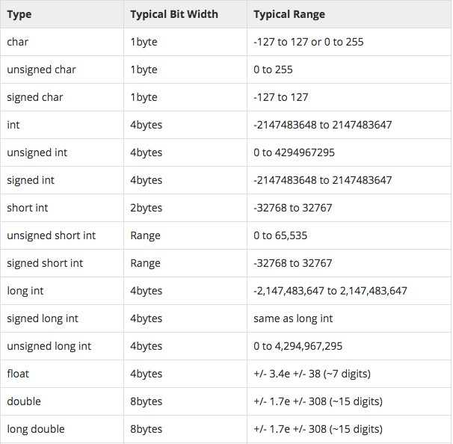
Data types – size and range!

Slide 15
Variables
 C++ is strongly typed language, so every
variable must be defined before using it.
 type variablelist; // type is the type (eg. int), varName is the name of the variable
 e.g:
int sum;
char ch;
float a, b;
 Variables when just declared have garbage value until they are assigned a value for the first time
 We can assign a specific value from the moment variable is declared, called as initialization of variable.[float b = 0.0;]

Slide 16
Statements & Expressions
 A statement in C++ is the smallest
independent unit in the language
 Statements in C++ are terminated by a semicolon
 An expression is a mathematical entity that evaluates to a value
 Expressions are often used inside of
statements.

Slide 17
Lets look at few statements and expressions!

Slide 18
Basic Operators in a Expression
18
 Unary [ +, - ]
 Arithmetic [ +, -, /, *, % ]
 Brackets [ () ]
 Assignment [ = ]
 Relational [ ==, !=, >, <, >=, <=]
 Logical Operators [ &&, ||, ! ]
PS - 1: Relational Operators and Logical Operators always Evaluate to 0 or 1
PS – 2: For logical evaluation any non-zero value is true.

Slide 19
If Block
19
 Single If
if (a > 10) {
cout << “Hello!”;
}
 If Else
If (a>10) {
cout << “Hello!”;
} else {
cout << “World.”;
}
 If .. Else If .. Else
If (a>10 && a <20) {
cout << “Hello!”;
} else if (a >20 && a <30) { cout << “Hello World!”;
} else {
cout << “Welcome to Coding Blocks”;
}

Slide 20
While block
20
while( condition is true ) {
//do some stuff
}

Slide 21
Lets convert some pseudocodes!
 Read P,R,T and calculate SI
 Find largest of 3 numbers
 Check if a number is prime or not
 Write a program to print the following
pattern
1
2 3
4 5 6
7 8 9 10

Slide 22
Recap
22
 Program Always starts with main()
 { } are used to enclose a block (function, if, while etc.).
 C++ Compiler Ignores whitespace (s p a c e, carriage returns, linefeeds, tabs, vertical tabs, etc.)
 Output using cout
 Input using cin
 Header Files
 Comments (// & /*… */)

Slide 23
Time to try?
 Given a list of N integers, find mean, maximum and minimum value. You would be given first N, and then N integers of the list.
 Print all prime numbers between 2 to N
 Read N and print the below pattern
1
232
34543
4567654
567898765

Slide 24
Time for Brain Teasers!
24

Slide 25
BT – 5: Circular Jail Cell
25
There is a circular jail with 100 cells numbered 1-
100. Each cell has an inmate and the door is locked. One night the jailor gets drunk and starts running around the jail in circles. In his first round he opens each door. In his second round he visits every 2nd door (2,4,6---) and shuts the door. In the 3rd round he visits every 3rd door (3,6,9---) and if the door is shut he opens it, if it is open he shuts it. This continues for 100 rounds (i.e. 4,8,12 ---; 5,10,15 -
--; ---; 49,98 etc.) and exhausted the jailor falls down.
How many prisoners found their doors open
after 100 rounds?

Slide 26
BT – 6: Greedy Pirates
A pirate ship captures a treasure of 1000 golden coins. The treasure has to be split among the 5 pirates: 1, 2, 3, 4, and 5 in order of rank. The pirates have the following important characteristics: infinitely smart, bloodthirsty, greedy. Starting with pirate 5 they can make a proposal how to split up the treasure. This proposal can either be accepted or the pirate is thrown overboard. A proposal is accepted if and only if a majority of the pirates agrees on it. What proposal should pirate 5 make?

Slide 27
BT – 7: Infinite Quarter Sequence
You are wearing a blindfold and thick gloves. An infinite number of quarters are laid out before you on a table of infinite area. Someone tells you that 20 of these quarters are tails and the rest are heads. He says that if you can split the quarters into 2 piles where the number of tails quarters is the same in both piles, then you win all of the quarters. You are allowed to move the quarters and to flip them over, but you can never tell what state a quarter is currently in (the blindfold prevents you from seeing, and the gloves prevent you from feeling which side is heads or tails). How do you partition the quarters so that you can win them all?

Slide 28
BT – 8: Daughters’ Ages
Local Berkeley professors Dr. X and Dr. Y bump into each
after a long time.
X Y
X Y
hey! how have you been?
great! i got married and i have three daughters
now
really? how old are they?
well, the product of their ages is 72, and the sum of their ages is the same as the number on that building over there
right, ok ... oh wait ... hmm, i still don't know
oh sorry, the oldest one just started to play the piano
wonderful! my oldest is the same age!
X
Y
X
How old are the daughters?

Slide 29
What is next class about?
29

Slide 30
Programming Fundamentals - 1
 Operators/loops
 Continue, b r e a k ;
 Arrays

Slide 31
Thank You !
Kartik Mathur
Kartik.mathur@codingblocks.com
+91-9560196180

